Slide 1
L&D VoC
Learner Workshop
October 26th, 2021

Slide 2
VoC Workshop Agenda
Guardrails, Objectives & Problem statement 10 min
Review of Learner's journey pain points 15 min
Design Thinking Session 60 min
Regroup & prioritization exercise 30 min
Next Steps 05 min

Slide 3
VoC Workshop Agenda
Guardrails, Objectives & Problem statement 10 min
Review of Learner's journey pain points 15 min
Design Thinking Session 60 min
Regroup & prioritization exercise 30 min
Next Steps 05 min

Slide 4
1. Basics:
We'd love to see you! Use video, please. ☺
What's that noise? Mute yourself when not speaking.
Ask away! Post them in the Zoom chat.
This is an interactive session: Your participation is key.
The session will be recorded: Please raise if any concerns
2. Approach:
Focus on what the user has said! That's why we're here.
Brainstorm with no limits: Go blue-sky & leave bias behind.
We are not locking anything today: We're just getting started.
3. Process:
We'll start with slides, then use Trello.
Review the learner journeys E2E and where pain points belong.
Breakout rooms will be used for Design Thinking.
We'll vote on priority using the DF framework
In scope: Primary focus on L&D digital tools
Output: Priority solutions for digital tools to test with learners
Some guardrails for a productive discussion

Slide 5

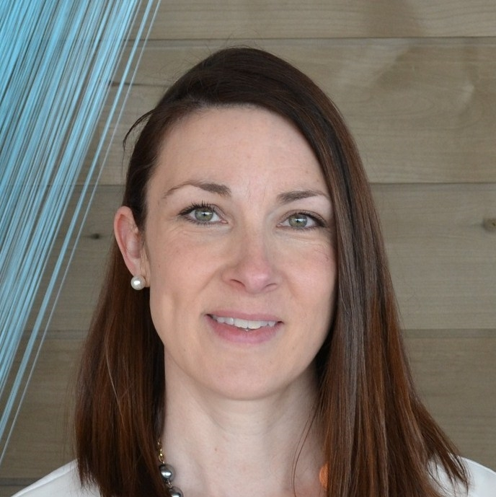



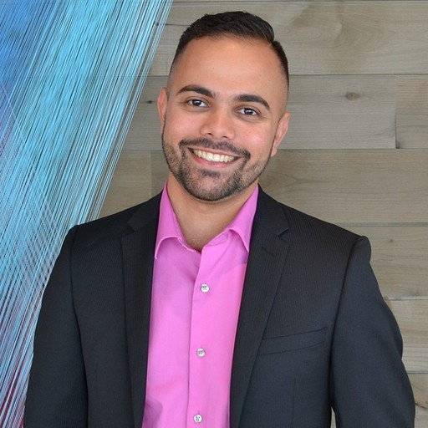



Today's Attendees
Ashley Egan
Director, Tribe Lead
HR Digital Products
Kate Venier
Product Owner - Senior Manager
Max Duggan
UX Designer
Freddie Winter
Global L&D Analytics Lead
Justin Straz
Global L&D Learning
Experience Product Manager
Thiago Oliveira
Operational Innovations
Senior Analyst
Rebecca Fell
Global L&D Learning
Experience Manager
Barbara Thompson
Learning Innovation Manager
Nick Raine
Global L&D Learning Experience Designer

Slide 6

Today's Objective & next steps
Focus for Today
1
Based on the results from the Merge qualitative research, (a) identify improvements that will help us move the needle the most, and (b) vote on their priority
3
Align with L&D leadership & get ready for BRP
Help define hypothesis from workshop outcomes and how to test for most meaningful results
2

Slide 7
These are the most impactful pain points for learners Trending across learner's archetypes
L&D Digital Tools
Problem statement: There's a gap between what learners expect and need, and what we deliver, because the current L&D's Digital Ecosystem lacks personalized, quick and simple learnings, and has poor bounce-ability*.
Lack of Personalized Learnings
Poor Discovery, Navigation & Usability
Missing Simplicity & Quick Learnings
*Ability to discover, navigate, and use learning platforms
Gap between what learners expect and what we deliver

Slide 8
VoC Workshop Agenda
Guardrails, Objectives & Problem statement 10 min
Review of Learner's journey pain points 15 min
Design Thinking Session 60 min
Regroup & prioritization exercise 30 min
Next Steps 05 min

Slide 9




Learner Journey* has pain points E2E Just in Time & Leisure
Learning Theme | Digitally enable world-class experiences for learners
Learning objective | Optimize learner's time spent learning by providing seamless, personalized, learning in-the-flow on platforms that are scalable for all BCG
Red=Key issues
Personalization & bounce-ability
Enter
Finding things: Browse
Fewer clicks to progress
Difficult to find all pertinent information about the course or program immediately
Using things: Navigate
Lack of fluid navigation within a course (learners move through unnecessary screen views with no bypasses)
Missing ability to easily go back to where they were (counter-intuitive back navigation)
Missing breadcrumb navigation (Workaround: Open content on different tabs)
Landing page is overwhelming
LAB should know which content is “for me.” (role, usage, goals)
Learners turn to external research due to easier and faster content exploration
Finding things: Search
Using things: Launch
Missing easier/clearer registration & launch path
Language is too complex (register vs. launch)
Length of videos and course duration is paramount
Missing ways to quickly highlight critical info and distinguish for relevance (e.g., lack of visual hierarchy)
Learners want to move fluidly between results to make fast determinations about relevance…and for quick learning.
Lack of relevant search results
Missing ability to further filter & refine
Coming Back
XXX
You might also like…
Update your preferences here…
Learners expect to set learning preferences and “AI” will push relevant content
*Identified by the Merge qualitative research

Slide 10
Learner Journey* has pain points E2E Pushed
Learning Theme | Digitally enable world-class experiences for learners
Learning objective | Optimize learner's time spent learning by providing seamless, personalized, learning in-the-flow on platforms that are scalable for all BCG
Red=Key issues
Personalization & bounce-ability
Finding Things
Using things: Navigate
Lack of fluid navigation within a course (learners move through unnecessary screen views with no bypasses)
Missing ability to easily go back to where they were (counter-intuitive back navigation)
Missing breadcrumb navigation (Workaround: Open content on different tabs)
Everyone wants an at-a-glance overview, as quickly accessible as possible.
Content-heavy emails are hard to scan for basic info: Must I attend? Why? Is it local? Where’s the link to act?
Missing ways to quickly highlight critical info and distinguish for relevance (e.g., lack of images on content)
Using things: Launch
Missing easier/clearer registration & launch path
Language is too complex (register vs. launch)
Length of videos and course duration is paramount
Coming Back
XXX
You might also like…
Update your preferences here…
Learners expect to set learning preferences and “AI” will push relevant content
*Identified by the Merge qualitative research

Slide 11
VoC Workshop Agenda
Guardrails, Objectives & Problem statement 10 min
Review of Learner's journey pain points 15 min
Design Thinking Session 60 min
Regroup & prioritization exercise 30 min
Next Steps 05 min

Slide 12

How do we improve? Design Thinking Session Structure
Merge Report
Priority Exercise
How do we improve these pain points?
How do we test our hypotheses?
What are the pain points identified by Merge?
How do we prioritize these improvements?
Design Thinking
Survey
Identified pain points by theme, place in the journey, and learner archetype
Three breakout rooms for brainstorming on each topic and adding cards to the board
Based on improvements identified, how do we prioritize using DF frame
Align on Survey methodology and how to test our hypotheses

Slide 13
Goal: Identify which improvements will help us move the needle the most on our digital tool usage & satisfaction
Design Thinking Session:
What exactly do we need to do?
60 mins
1
Review team's pre-work on designated theme (10 min)
Do they make sense? Will they achieve our goal?
What duplicate improvements can we combine into one card?
Identify and brainstorm other options (40 min)
Think bold: How will the learner benefit from it?
Summarize insights & sort cards based on potential impact (10 min)
What work is interdependent to move the needle? (e.g.: if we don't do A, B will have no effect).
2
3
4
Workshop Trello Board
Breakout rooms will be split by pain point themes, so each group can focus on solving for each (3 groups of X each)
5
Plenary: Bring back the following to share:
One member of each group will share discussion highlights and their Trello Theme List of solutions

Slide 14
VoC Workshop Agenda
Guardrails, Objectives & Problem statement 10 min
Review of Learner's journey pain points 15 min
Design Thinking Session 60 min
Regroup & prioritization exercise 30 min
Next Steps 05 min

Slide 15
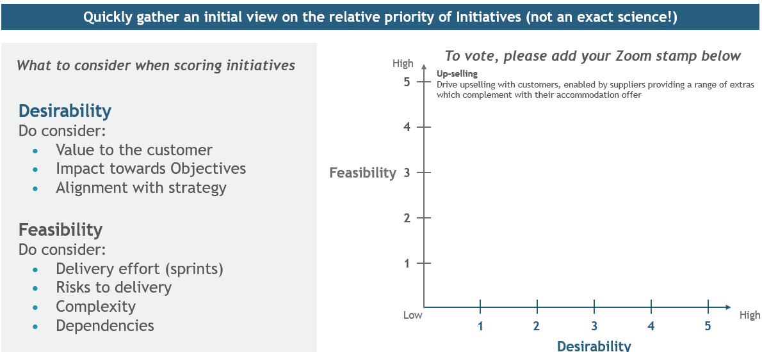
DF is the backbone to prioritize what is most valuable & should be built out for learner feedback
Desirability: Does this meet the learner's needs?
Will this solution fill a need?
Will it fit into people’s lives?
Will it appeal to them?
Will they actually want it?
What is DF?
DF prioritization is a technique to prioritize based on a focus on customer desirability & business delivery feasibility
Feasibility: Can we deliver it? Does this make good business sense?
What is the delivery effort?
Do you have, the knowledge, skills and tools needed to do this?
Can your squads make it happen?
Does it align with strategic objectives of the L&D squad and HR Tribe?
Does it align with the amount budget ambitions?
Is the payoff worth the effort and cost?
What is the cost of not doing it?

Slide 16
VoC Workshop Agenda
Guardrails, Objectives & Problem statement 10 min
Review of Learner's journey pain points 15 min
Design Thinking Session 60 min
Regroup & prioritization exercise 30 min
Next Steps 05 min

Slide 17
Learner Milestones| Our path to 2022 digital priorities
Oct
Nov
25.
01.
08.
15.
22.
29.
What is happening?
25
26
27
28
29
1
2
3
4
5
8
9
10
11
12
15
16
17
18
19
22
23
24
25
26
29
30
Learner Solutioning Workshop
Summarize ideas from workshop
Develop Survey
Align ideas & quant w/ L&D Leadership
Target survey sent out
Target survey responses due
Survey response analysis
Share prelim results w/ L&D Leaders
Initiative planning session with PO
Big Room Planning
US Thanksgiving
+ Vacations

Slide 18
Appendix

Slide 19
Learning | Move the needle on satisfaction by tackling opportunities driven from the voice of the customer
Learners
Learning admin
Personalization
LAB "knows" which courses are relevant for you
Feedback process
Efficient creation, distribution & analysis of surveys
Simplification
Learners can move in between offerings, meaningfully
Reminders & Nudges
Automated notifications and follow ups
Discoverability
Learners can easily understand if training is mandatory, how long it will take, what is covered
Wholistic Analytics for Journeys
Enable reporting and analytics for Journeys using data from multiple systems

Slide 20
HR Tribe Vision, Priorities and Themes
Strategic Priorities
2-5 years
Attract & onboard world class talent
Retain, promote, & develop employees
Improve employee engagement & satisfaction
Scale to improve HR productivity
Tribe Vision
Unlocking potential as the best developer of talented people in the world
1
OneHR
Progress on our journey toward one end-to-end HR experience for employees by bringing more HR products into Agile (e.g., Wave II, Ombudsman, Whistleblower)
2
Bionic
Use data to personalize products, inform predictions, and enable better decision making
3
4
Digitization
Modernize technology & create common data foundation to prepare for cloud readiness and "future-proof" positive impact delivered
End-user impact & efficiency
Deliver products & improvements that create positive experiences for our employees, candidates, & HR functions – streamline workflows & save time for our employees
Themes
1-3 years

Slide 21
HR Tribe: Learning & PTO area
May 17
Learning leadership | Tribe lead: Ashley Egan Area MDP: Ian Frost Area Lead: Lidia Juszko, Ulrike Beemelmanns Tech Area Lead (Interim): Scott Mirley Functional leads: Tom Guillou, Francesco Ferretti Product Owners: Kate Venier, Jean Whitney
Learning Theme | Digitally enable world-class experiences for learners and provide efficient tools for L&D teams via eco-system of integrated platforms & tools, that provides L&D teams with data to inform and make strategic decisions about offering
Learning objective | Optimize learner's time spent learning by providing seamless, personalized, learning in-the-flow on platforms that are scalable for all BCG
Learning sub-themes | Enable learner experiences: Deliver and embed digital ecosystem used by learners to access programs, content and learning journeys; ensure seamless experience between and deliver high value capabilities for all learners (One-BCG) Operational efficiency for L&D: Deliver and embed new tools and platforms that improve efficiency of existing ecosystem used by L&D to deliver programs and content to learners and manage key operations processes for all BCG (one-BCG) Reporting and analytics: Enable access to data and tools to measure platform success, derive actionable recommendations, support change efforts, support decision making for L&D teams and L&D leadership PTO tools and experience: Enable PTO and case leadership to have easy and constant access to updated, relevant data in order to make sustainability adjustments for their teams; provide intuitive and accessible survey tool for case team members
Functional objectives, for reference | 1. Deliver on our EVP by more personalized learning More equitable & raised quality bar amongst systems Stronger learner experience incl. integration with HR connection points 2. Quickly upskill on emerging business needs (e.g., DigitalBCG, NGWOW) 3. Accelerate to OneBCG Inclusive mindset & distinct needs More joint in-person experiences & stronger affiliation 4. Reduce carbon emissions by 50% by 2026 From 11 to 6 in-person core programs over BCG career, equating to 1 program per career step Optimize location & attendance mix
Scope | In scope: Saba Cloud LMS, EdCast LXP, WalkMe, mobile, Saba microapps, Saba workspaces, DF integration, compliance, WD integration, coaching tools, PTO tool, external content provider integrations Out of scope (for now): Connected Classroom, content authoring tools, podcasts app, MS Teams/Slack

Slide 22
What is the problem?
What are we doing about it?
Target user feedback on L&D and LAB has been declining: NPS, People Survey, Quarterly Pulse Checks.
Team has leveraged some quant & qual user feedback to try to identify key pain / intervention points…
…and has tested several potential improvements…
…but the needle is not moving enough.
The L&D VoC aims to build confidence and prioritize solutions to root causes of pain points in our customer's experience– learners and L&D admins. More specifically:
Identify largest root causes of pain & intervention points - to take on as a function – whether digital or not
Quantify the impact potential improvements will have on improving L&D feedback & usage
Prioritize roadmap effectively; What digital tools' initiatives should the HR function prioritize to improve our learners' experience in Q4/2022 and beyond?

Slide 23



Identify root causes of pain and intervention points
Who is our learners? What are their needs? Where do they go for them?
Where/how/why they experience the most friction?
What is driving leaner frustration and poor experience?
Quantify size of the opportunities
What digital solutions/initiatives will move the needle the most?
What opportunities offer the most value for the HR tribe?
The L&D VoC "quick burst" has three main objectives:
Prioritize roadmap effectively
What digital tools' initiatives should the HR function prioritize to improve our learners' experience in Q4/2022 and beyond?

Slide 24
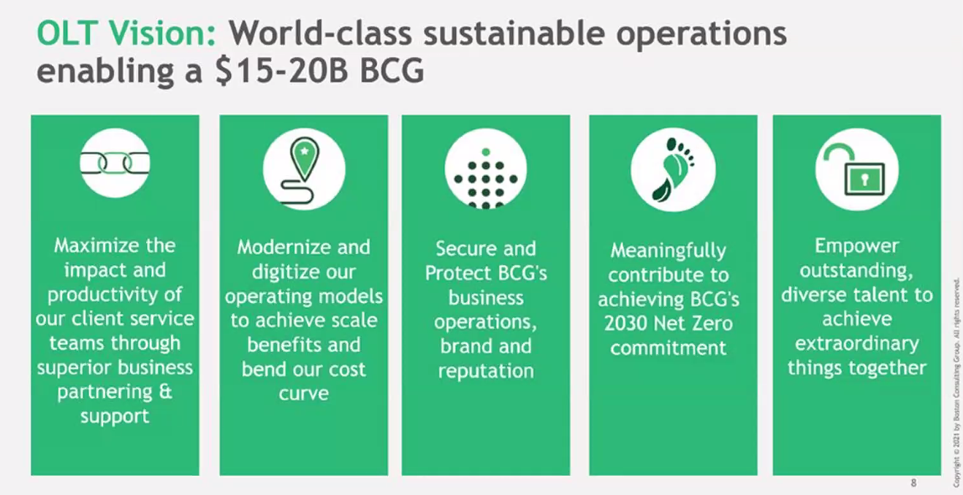
Reminder | Will align 2022 priorities to OLT vision
Increase CT
productivity
Digitize to scale
Secure & protect BCG
Contribute to Net Zero
Empower our talent

Slide 25
ABR themes for L&D
We have a clear idea of the major focus areas for L&D
Digitally enable world-class experiences for learners: e.g. discovery, usability, personalization
Increase operational efficiency for L&D function: e.g. through automation, integrations
Improve reporting & analytics: e.g. via integrations, updates, & new features
We are working closely with our customers – learners and L&D admins – to understand root causes & identify solutions that will move the needle for ESAT for LAB
Currently completing a targeted VoC initiative to identify roadmap priorities for 2022
Anticipate our L&D roadmap for 2022 will include both evolutionary ideas & revolutionary innovations + "moonshots," e.g. personalization, AI, bionic learning
Will focus on prioritizing current resources but may need new skillsets or capacity depending on scale of work
Potential investments: LT VoC investment; AI resourcing, (+ continued focus on backfills / unfilled roles)

Slide 26
Linking deliverables to value enables squads to work on top priorities
Level
Link desirable outcomes and value …
… with specific deliverables for tribes and squads …
… and measure progress using OKRs
Firm
BCG's strategic priorities
Functional outcomes
Key outcomes the function wants to achieve
Tribe Vision / priorities (3-5 years)
Strategic focus linked to the overarching strategy
Tribe
Themes (1-2 years)
Areas of focus to achieve the vision
Objectives
Outline of what to achieve or where to end up
Value drivers
Drivers that will help accomplish the functional outcomes
Initiatives (3-9 months)
Major deliverables that enable accomplishment of themes and creation of roadmap
Key results
Measurable outcomes / levers to help achieve objective
Measured through metrics that help quantitatively identify the correct value drivers
Epics (1-3 months)
Multi-sprint deliverable, to accomplish part of the initiative
Tribe/ Agile Metrics
Measurement system to validate key results and create data for decision making
Squad
Stories (<2 weeks)
Single sprint deliverable for a squad

Slide 27
L&D | Value driver tree (I/II)
High
Medium
Low
Roadmap deliverables (initiatives)
Outcomes
Value bucket
Drivers / sub-themes
Metrics for 2022
Digitally enable world-class experiences for learners
Increase CT impact &
productivity
Automation
Provide automation for learners (e.g. reminders)
H
Improve discovery & usability
Improve ecosystem navigation as per 2H21 portal assessment, VoC analysis
H
Improve content discovery experience (e.g. search, browse – pending VoC analysis)
M
Support regularly scheduled SaaS product upgrades/new features, BCG system updates, fixes & improvements
L
WORK IN PROGRESS
Support digital adoption of other applications via WalkMe integration
Digitize to scale
Enable learning innovations
Enable pilot and adoption of digital credentials using Credly
H
Enable learning in the flow via integrating learning with MS Teams
M
Empower our talent
Personalized learning
Enable personalized messaging (e.g. SFMC, Marketo)
H
Enable more tailored experiences (e.g. using recommendations, skills)
H

Slide 28
L&D | Value driver tree (II/II)
High
Medium
Low
Outcomes
Value bucket
Drivers / sub-themes
Roadmap deliverables (initiatives)
Metrics for 2022
Increase operational efficiency for L&D function
Digitize to scale
Implement SSOT reporting and analytics for learning data for insight to engagement and usage
Integration of learning data platforms, other providers, WD and other HR data. Enable better talent management and deeper data analysis
Empower our talent
Implement reporting & analytics for journeys in EdCast using combined data
H
Evolve Saba reporting suite with new reports and adapt for new features
L
Empower our talent
Increase efficiency of current tools
Improve Feedback Administration process & tools (pending VoC analysis)
H
Improve L&D efficiency by increasing use of Saba automation (e.g. nudges, automatic assignments, waitlists)
H
WORK IN PROGRESS
Support regularly scheduled SaaS / BCG product upgrades/new features
H
Digitize to scale
Integrations / third-party resources
Technical integration of external content providers including SSO
L
Ensure compatibility of content authoring tools & learning content
H
Secure & protect BCG
Automate global compliance program
Technical set-up & support for delivery of global compliance programs, improvements to processes (e.g. email shut off)
H

Slide 29
Learner archetypes have different needs & behaviors Learners can have multiple archetypes
Just in time
Leisure
Passive
I am…
I am
frustrated by…
I need…
Juggling multiple demands on time
Accountable for high output
Proactive about using resources
Things that feel like waste of time
Reliable and efficient path to resources
Quick access to core concepts/expertise building
Ability to re-find something I previously found useful
Typically looking for something specific
Interested in building expertise/mastery
Able to dedicate chunks of time to learning
Feeling like I've wasted time browsing
An intuitive way to find out what's available
An easy way to pick up where I left off/resume
Focused on other priorities (not learning)
Having an inefficient experience when I do end up in a platform
Overwhelming choices that feel more confusing
Reminders/nudges/incentive to engage
Shortest path to interaction

Slide 30




Summary VoC for Learners
Finding Things
More relevant search results
Ability to further filter & refine
Tags or other ways to quickly highlight critical info
Connections across the ecosystem
JIT
JIT
Using Things
Easier / more clear registration & launch
Fewer clicks to progress
Leisure
Better navigation within a course
Leisure
Ability to easily go back to where they were
Coming Back
You might also like…
Update your preferences here…
Pushed
We saw you went to X, you might want to try Y…

Slide 31
These are the most impactful opportunities for us to test
Finding Things
Using Things
Other Considerations
Text
Text
Text

Slide 32
How do we test them for most meaningful results?
Overall Objective:
Help determine/prioritize what initiatives/moonshots/changes will move the needle* the most.
What must be learned from the survey output?
What is the least I need insight on from the survey?
What depth of response are we looking for?
*move the needle = Improve learner's satisfaction with BCG learning platforms.

Slide 33

L&D Milestones| Our path to 2022 digital priorities
Today
Qualitative Insights
Read-out
ABR Pre-read Due
ABR Market with IC
Solutioning Workshop & Quant Survey
Prioritization
Workshop with L&D Leadership
Big Room Planning (BRP)
Oct 12
Oct 15
Oct 25
Oct 18 – Nov 1
Nov 1 – Nov 15
Nov 18
MERGE* presents findings from customer research to L&D leadership & stakeholders
Focus is on vision & themes for the squads & the tribe as a whole
Early VoC themes will help guide major focus areas for L&D
90-min meeting to discuss HR Tribe high-level direction for all squads
L&D messaging will feature some "moonshots" …
…as well as more evolutionary inits.
Will not discuss at the initiative level
Workshop potential solutions & quantify impact (via survey)
Build one-pagers for priority initiatives
Gather priorities from L&D Learning Council (Oct 20)
Vote on priority initiatives & clarity resourcing
L&D Leadership to help prioritize potential initiatives from VoC outcomes (solutioning workshop, quant survey, qualitative insights, etc.)
L&D squads to build initiative-level plan for 2022 based on results from VoC work (& other priorities, e.g. technical IT requirements)
*MERGE is our external partner conducting customers' interviews

Slide 34
Nov 18th BRP| How do we get there?
Solutioning Workshop
Finalize & Send quant Survey
Analyze quant results & write initiatives
Prioritization Workshop w/ L&D Leadership
Big Room Planning
Oct 21st
Oct 22nd
Week of Nov 1st
Nov 11th
Nov 18th
Objective: Brainstorm potential solutions for most impactful root causes identified by MERGE and ways to quantify/prioritize them.
Audience & Format: VoC Project Team; 2-hour virtual session.
Objective: Align, write and send additional questions based on solutioning workshop to help quantifying and ranking initiatives.
Audience & Format: Ashley, Kate, Jean, Freddie, Thiago & EIP; Survey Due Date: Oct 29th.
Objective: Analyze and rank solutions based on additional data, and refine plans as needed.
Audience & Format: VoC Project Team; 2 full working sessions + Time with POs separately.
Objective: Prioritize and link deliverables to values and strategic direction of the L&D squad.
Audience & Format: Ashley, Kate, Jean, Freddie, Thiago, Tom, Ulrike, and Lidia.
Objective: Present 1-pager initiative-level plan for L&D 2022 based on qual and quant outcomes from VoC.
Audience & Format: HR Tribe Leadership, POs; 90-min.
Initial Questions for Solutioning Workshop:
What are all the ideas we already have based on qualitative insights (visionary and non-visionary)?
What are the intersections between VoC & Portal assessment?
What about personalization we want to solve for and how?

